Slide 1
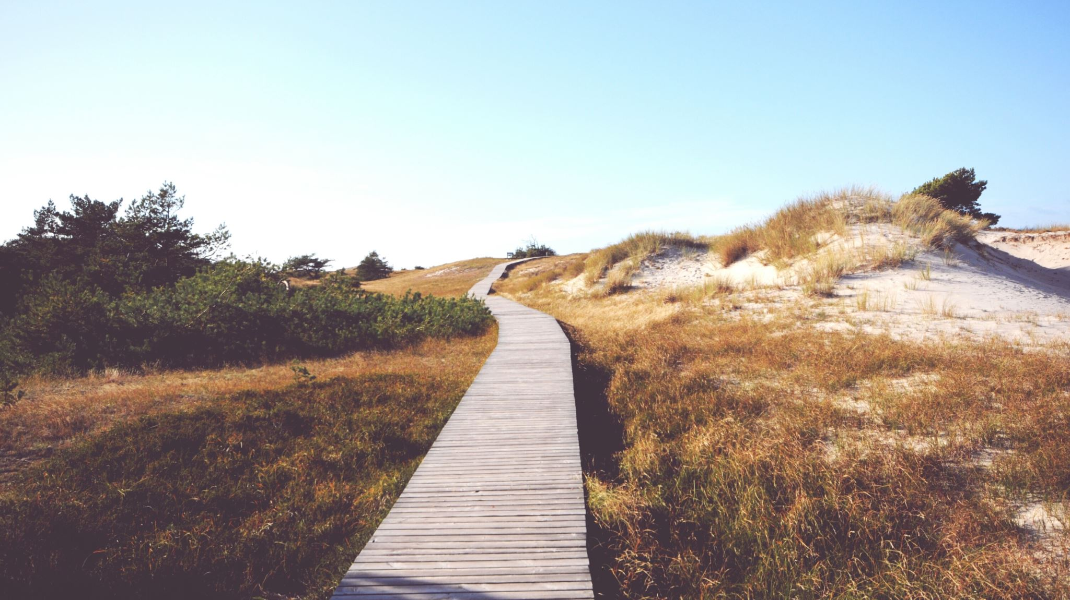
traveling Salesperson problem

Slide 2
Let G = (V, E) be a directed graph with edge cost c_{ij}.
The variable c_{ij} is defined such that c_{ij} >0 for all i and j and c_{ij} = ∞ if <i, j> not in E.
Let |V| = n and assume n >1.
A tour of G is a directed simple cycle that includes every vertex in V.

Slide 3
The cost of a tour =sum of the cost of the edges on the tour.
The traveling salesperson problem is to find a tour of minimum cost.
TSP has variety of applications in variety of situations

Slide 4
Let g(i, S) be the length of a shortest path starting at vertex i, going through all vertices in S, and terminating at vertex i.
The function g(1, V-{1}) is the length of an optimal salesperson tour.

Slide 5
g(i, ø) = c_{i1}, 1<=i<=n.
From the principle of optimality it follows that
g(1, V-{1}) = min{c_{1k} + g(k, V-{1,k} ) }

Slide 6
A tour to be a simple path that starts and end at vertex 1.
every tour consist of an edge <1, k> for some k є V – {1} and a path from vertex k to vertex 1.
The path from vertex k to vertex 1 goes through each vertex in V – {1,k} exactly once.
It is easy to see that if the tour is optimal, then the path from k to 1 must be a shortest k to 1 path going through all vertices in V – {1, k}.
Hence principle of optimality holds

Slide 7
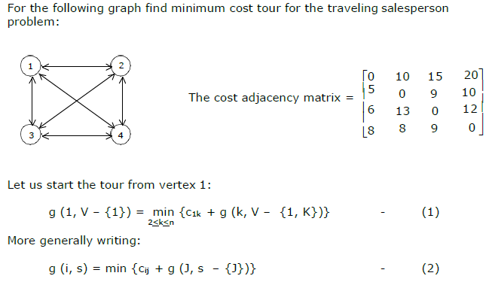

Slide 8
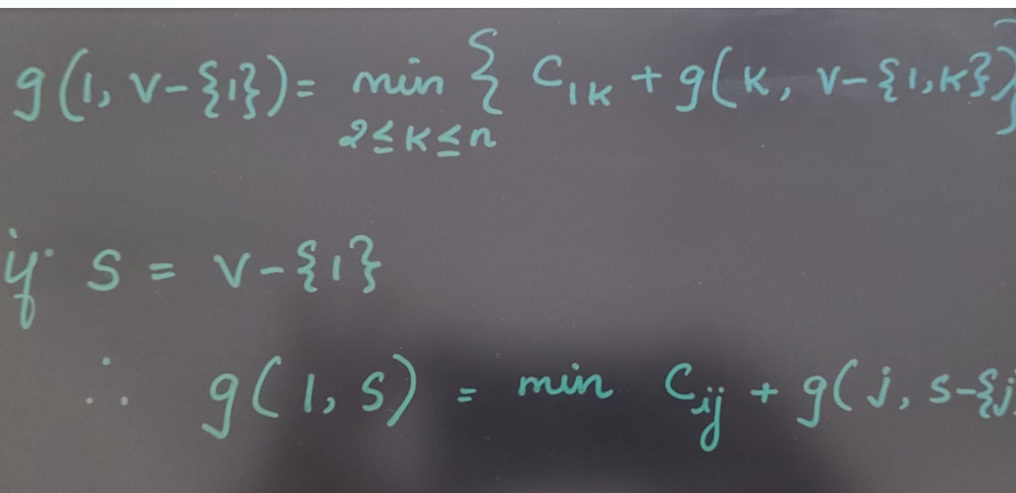

Slide 9
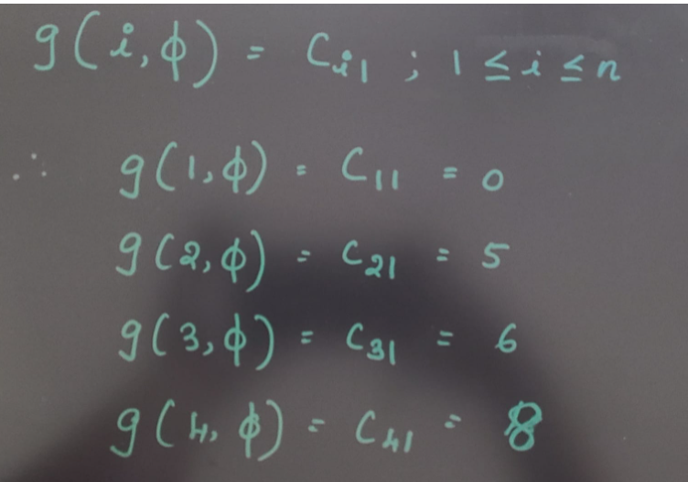

Slide 10
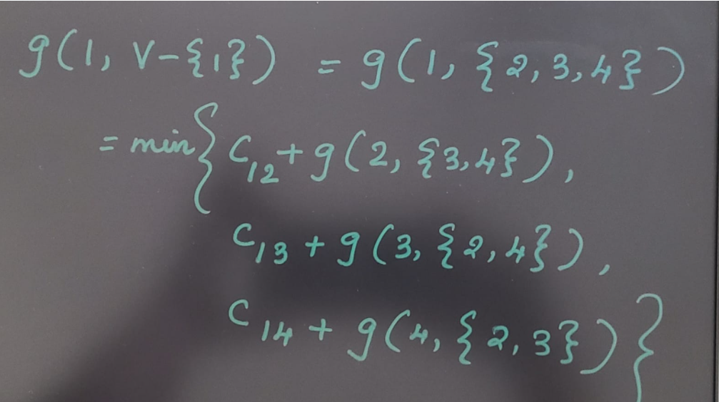

Slide 11
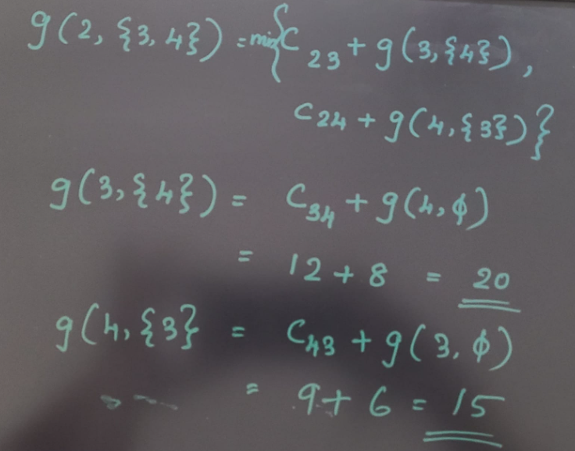

Slide 12
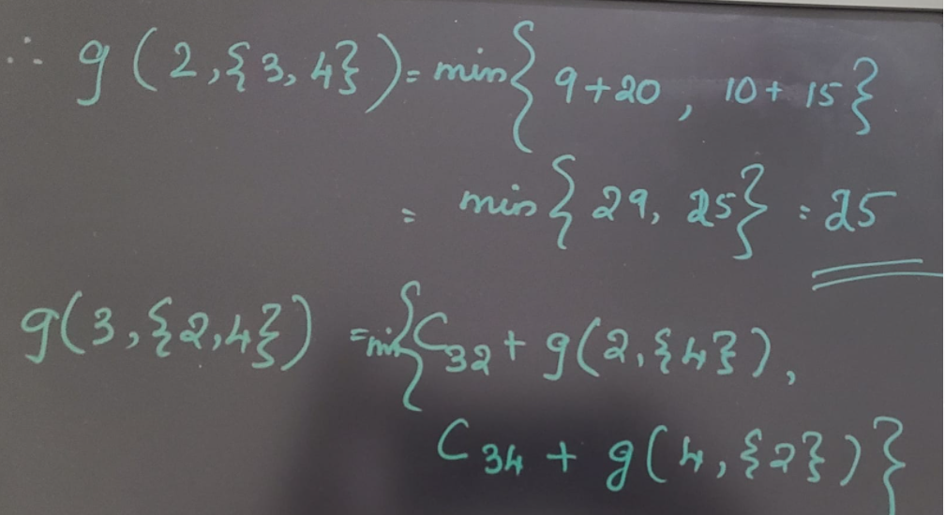

Slide 13
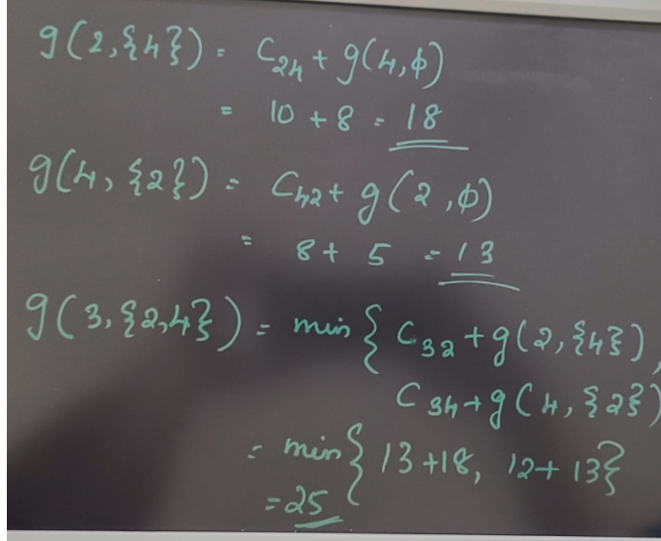

Slide 14
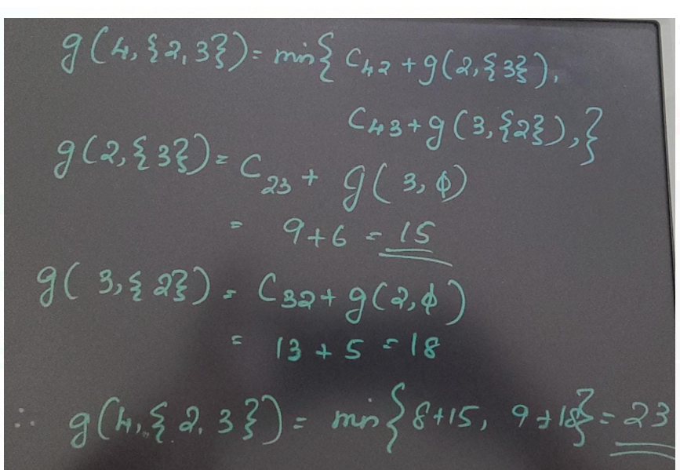

Slide 15
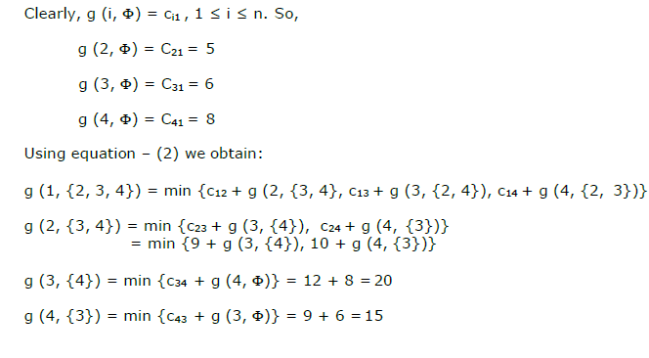

Slide 16
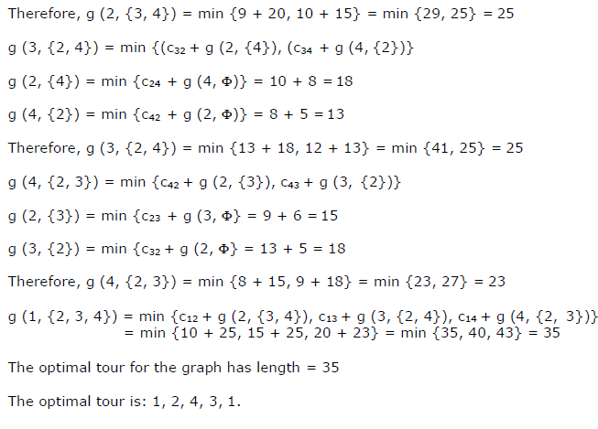

Slide 17
Solve the following travelling sales person problem using dynamic programming. Let the distance matrix be
 | A | B | C | D
A | 0 | 2 | 9 | 10
B | 1 | 0 | 6 | 4
C | 15 | 7 | 0 | 8
D | 6 | 3 | 12 | 0

Slide 18
Optimal TSP tour: 1 -3 – 4- 2 – 1 A-C-D-B-A

Slide 19
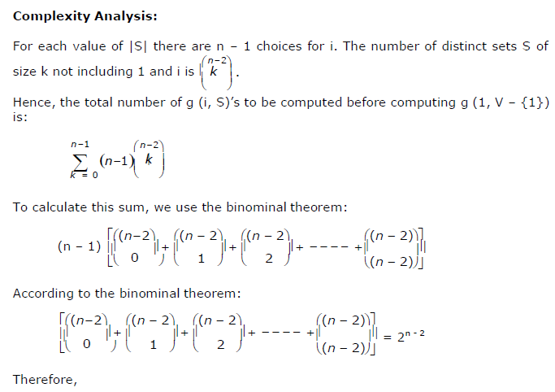
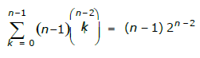
This is Φ (n 2^{n-2}). Calculating one g (i, S) require finding the minimum of at most n quantities. Therefore, the entire algorithm is Φ (n² 2^{n-2}).

Slide 20
EXAMPLE OF DYNAMIC PROGRAMMING ALGORITHM FOR THE TSP
Distance matrix:
C =
0 2 9 10
1 0 6 4
15 7 0 8
6 3 12 0

Slide 21
g(2,O/ ) = c21 = 1
g(3,O/ ) = c31 = 15
g(4,O/ ) = c41 = 6

Slide 22
k = 1, consider sets of 1 element:
Set {2}: g(3,{2}) = c32 + g(2,O/ ) = c32 + c21 = 7 + 1 = 8 p(3,{2}) = 2
g(4,{2}) = c42 + g(2,O/ ) = c42 + c21 = 3 + 1 = 4 p(4,{2}) = 2
Set {3}: g(2,{3}) = c23 + g(3,O/ ) = c23 + c31 = 6 + 15 = 21 p(2,{3}) = 3
g(4,{3}) = c43 + g(3,O/ ) = c43 + c31 = 12 + 15 = 27 p(4,{3}) = 3
Set {4}: g(2,{4}) = c24 + g(4,O/ ) = c24 + c41 = 4 + 6 = 10 p(2,{4}) = 4
g(3,{4}) = c34 + g(4,O/ ) = c34 + c41 = 8 + 6 = 14 p(3,{4}) = 4

Slide 23
Length of an optimal tour:
f = g(1,{2,3,4}) = min { c12 + g(2,{3,4}), c13 + g(3,{2,4}), c14 + g(4,{2,3}) }
= min {2 + 20, 9 + 12, 10 + 20} = min {22, 21, 30} = 21
Successor of node 1: p(1,{2,3,4}) = 3
Successor of node 3: p(3, {2,4}) = 4
Successor of node 4: p(4, {2}) = 2
Optimal TSP tour: 1 ĺ 3 ĺ 4 ĺ 2 ĺ 1

